Slide 1
CUSP GEANT4 status
Giovanni De Cesare February 14 2024

Slide 2
Items lists
Done (results stored in the shared Google Drive GEANT4CUSP)
Basic tests of the Monte Carlo code
github repo organized with a directory (send_box) for user contribution (to avoid conflicts)
Parallel 60 keV beam with 100 % polarized and unpolarized photons
Comparing unpolarized physic list with polarized with p = (0,0,0) -> same results, as expected
Point like 60 keV beam impinging on one detector (see the screenshot)
To Do (coming soon…)
Toy model (gdml integration)
Test of different physics list (as suggested by Riccardo)
Better organization of the archive and data (file naming, fit header, etc…)

Slide 3
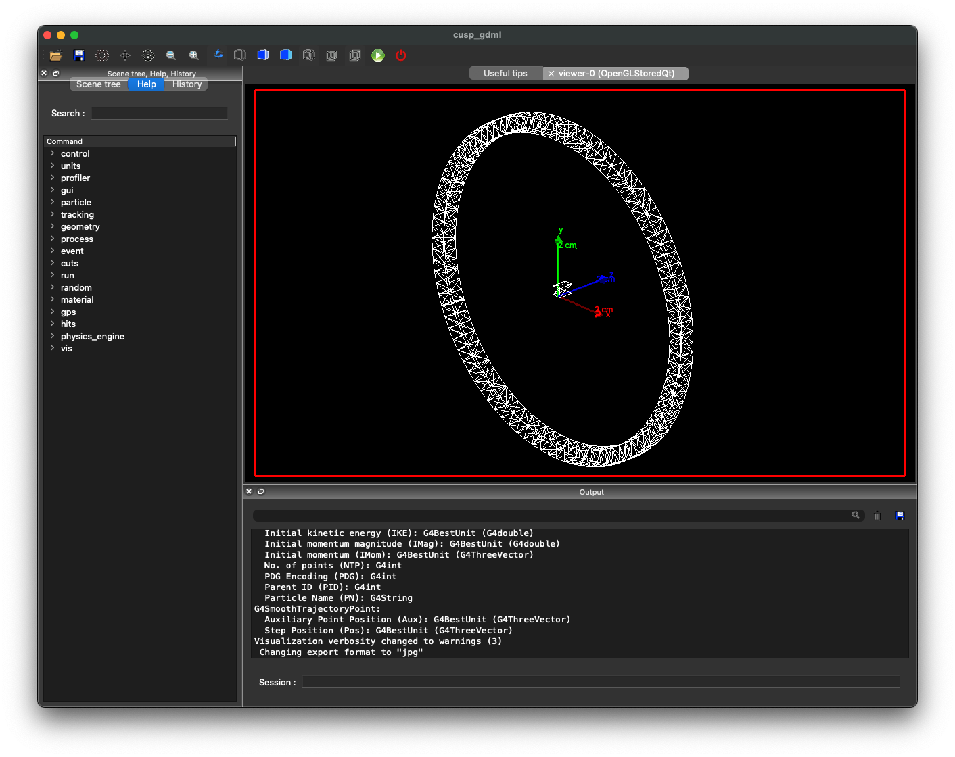
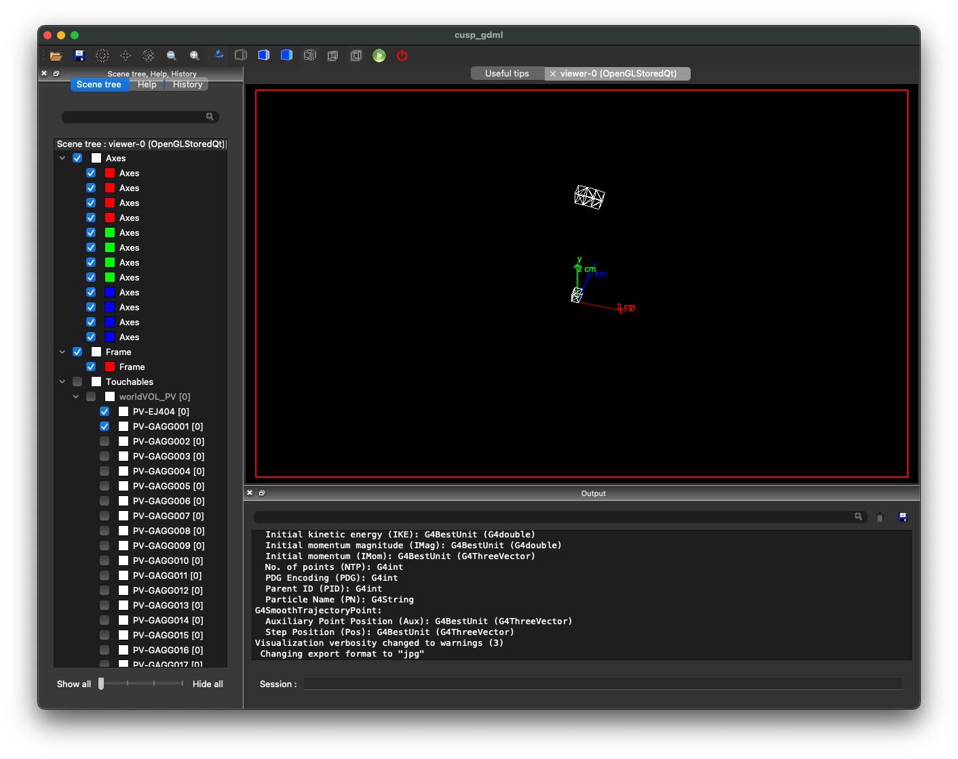
Toy model (GEANT4 GUI) - toy_model git branch

Slide 4
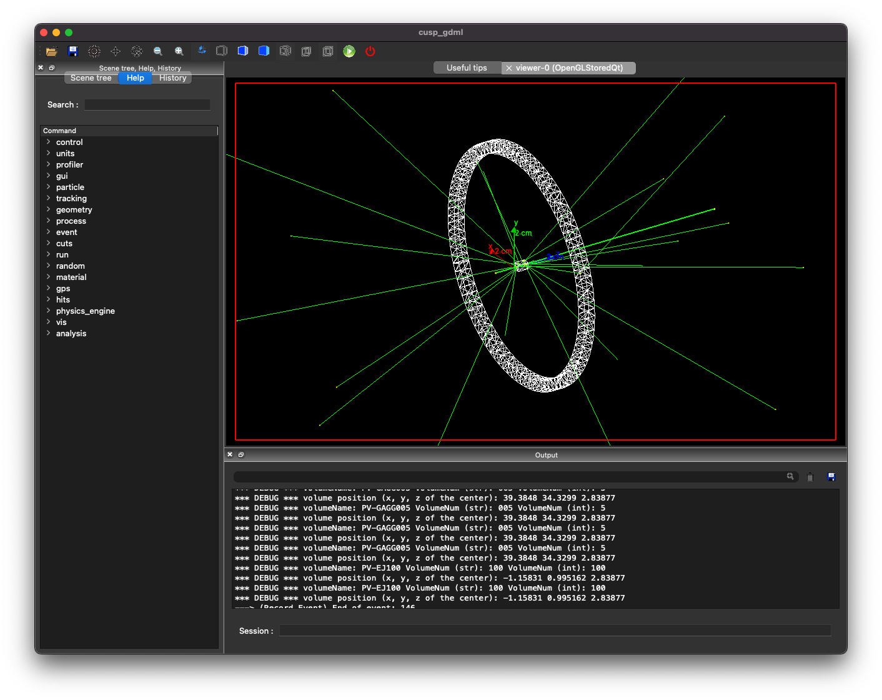
GEANT4 tracking: 60 keV photons point like beam

Slide 5
Coming soon (by tomorrow)
Toy model v1,2,3 events data release (one for each detector position on Google drive)
Quick look
Data analysis

